Slide 1

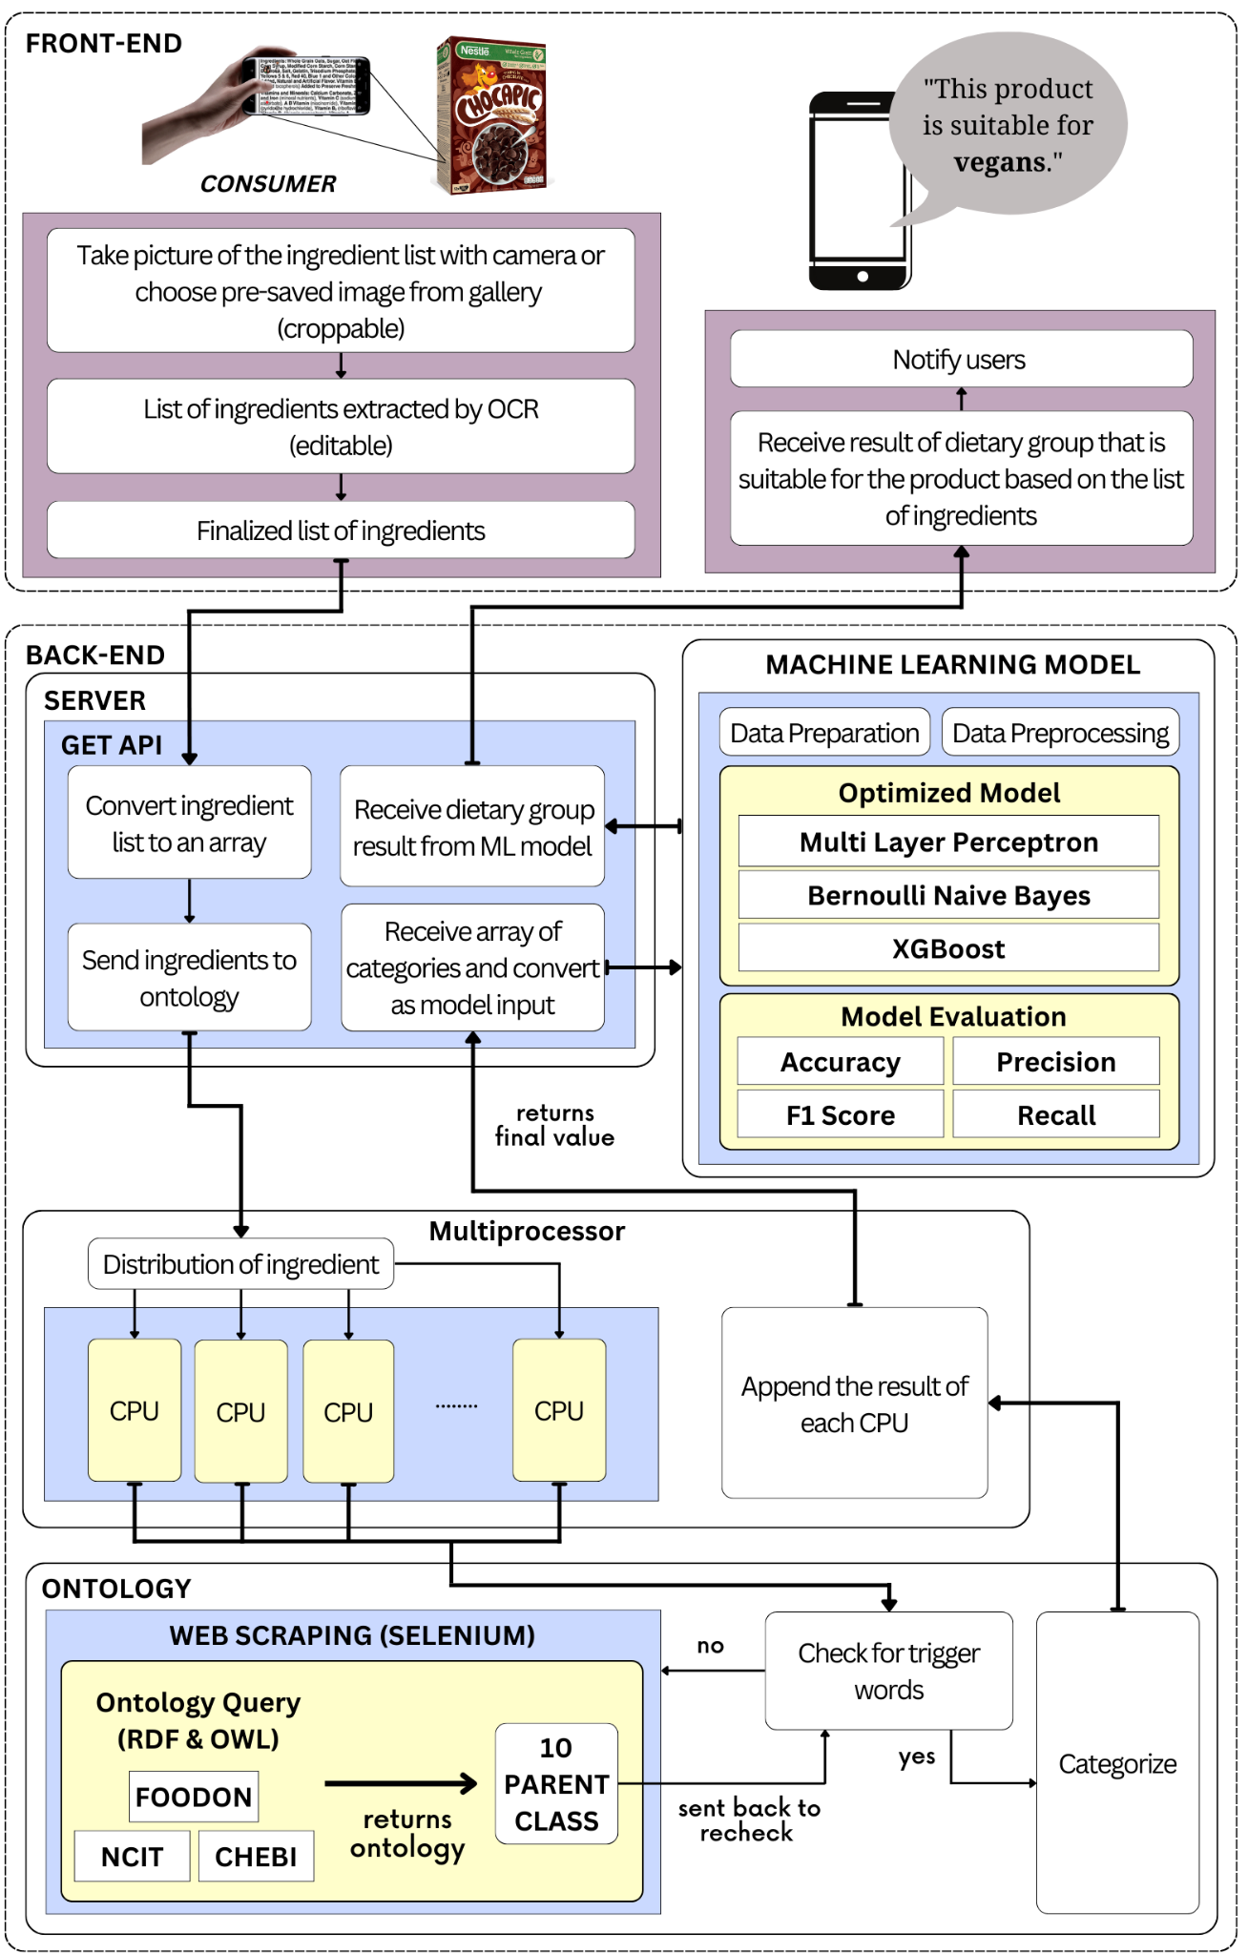
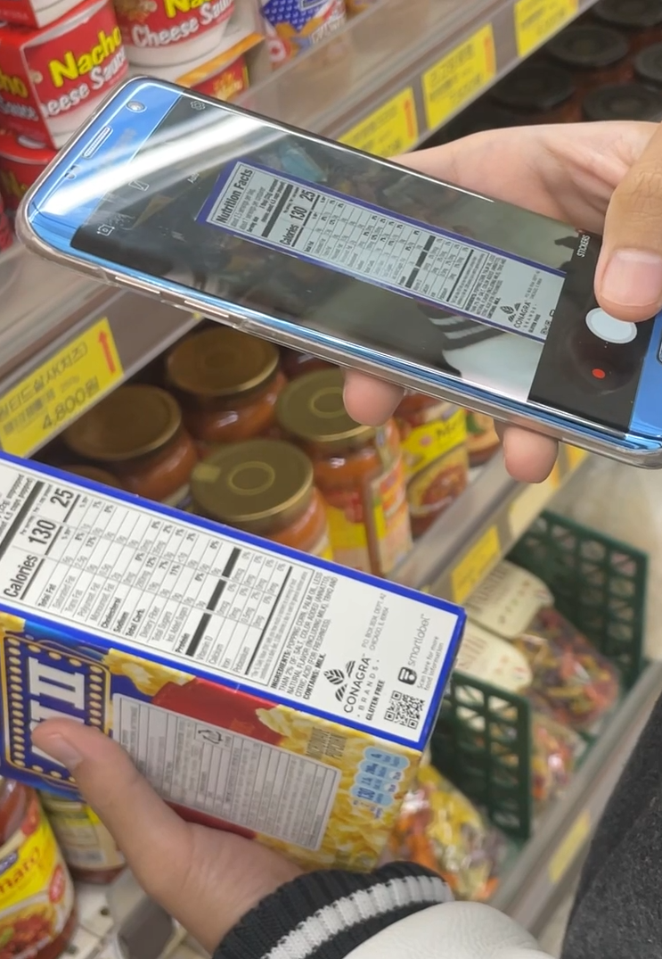
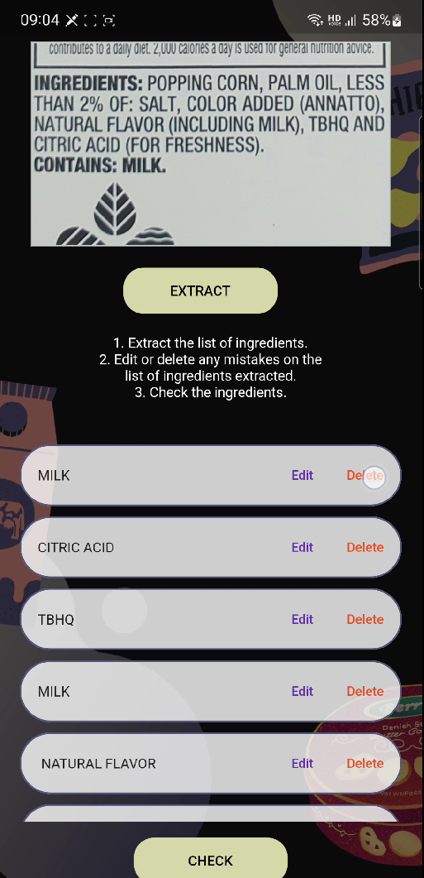
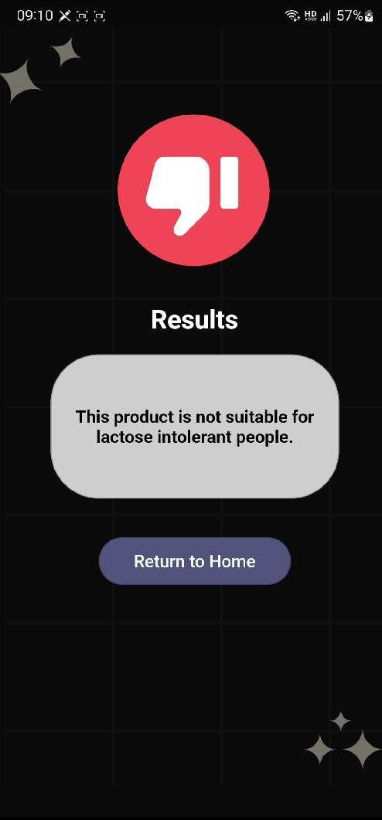
성균관대학교 소프트웨어융합대학
연구작품
Smartphone-Based Food Assessment
Using Semantic Ontology and Deep Learning Aizat Hamizuddin Bin Azlan, Amirah Binti Ahmad Nadzri,
Fatdzirul Izzat Bin Abdul Radzi, Nurlaili Binti Zainal Abidin
Department of Computer Science and Engineering, Sungkyunkwan University
지도 교수: Prof. Tamer Abuhmed
연구실명: InfoLab - Prof. Tamer Abuhmed
ⓔ
ⓔ
Overview
Method
Personal food diet preferences or dietary restrictions have been embedded in our culture through the existence of religions and beliefs, however there are some food diet which not only tied to health restrictions but also tied to human physiology, moral values or sometimes even by choice. A few examples such as lactose intolerance, gluten intolerance or sensitivity, vegetarianism, veganism, and shellfish intolerance.
Sometimes, consumers with these dietary restrictions faces difficulties and uncertainties when purchasing food products as factory-made goods are sometimes not transparent in informing the consumers regarding the ingredients that are used in the products.
In this project, we aim to directly assist people all over the world in further analysing their preferred goods and obtaining more information on whether the goods being sold are aligned with their dietary restrictions by creating a mobile application that utilises existing ontology on food classifications, and multiple Machine Learning models in Artificial Intelligence.
We created a user interface for the user to capture an image of the ingredients of the product or choose a pre-existing image in the device gallery where the list of ingredients will then be extracted from the image. The data will be sent to the server side for intensive computational analysis which cannot be done in the client side.
In the server side, we use different artificial intelligence methods including ontology classification where the ontology labelling will be sent to the machine learning algorithm that can classify the ingredients based on the abstract representation of each of the ingredients.
After the machine learning (ML) model has been initial trained, it will predict which class does the product belong to. We have 7 types of classes which are vegan, lactose intolerant, egg intolerant, pescatarian, pollotarian, lacto-ovo vegetarian and none of the above. After the machine learning predict the class, the result will be sent back to the client side. The client will notify the user whether the product is suitable for the user to consume or not.
ⓔ
Framework
ⓔ
Results
After optimizing the training model, our model has achieved an accuracy of 96.8%. The images below show the result of the model on the app after the scanning and extraction of the ingredients.
ⓔ
Conclusion
Shopping for food products is not an easy task for those who are practising a certain dietary restrictions whether it is due to health reasons or personal preferences, and it is a problem that should be ignored. We created a mobile application that allows the user to take a picture of the ingredient list and the server side will predict an output whether it is suitable for the user to consume or not. During our optimization process, the ML model achieved a good result with an accuracy of 96.8% for its prediction.
For future improvements, religious dietary restrictions can be included to provide assistance to wider diversity groups. Other variety of languages can also be implemented in the project. Finally, the efficiency of the ontology query in terms of time taken to return the result of the query can also be improved.

